Slide 1
Human Resources Console Application
Trifon Trifonov

Slide 2
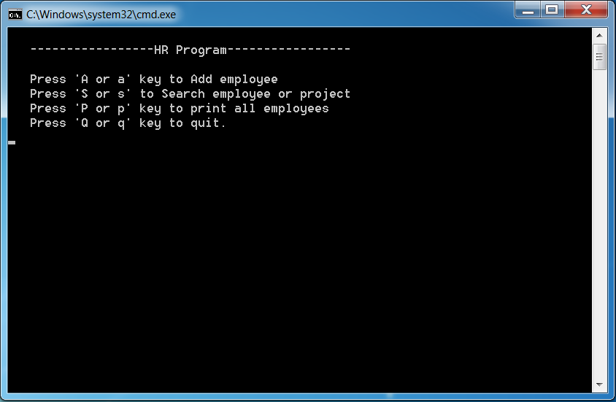
Agenda
Functionalities
Structure

Slide 3
Functionalities
Add Employees:
Recommendatory Fields - Name, Position;
Eligible Fields - Project, Project Manager, Team Leader, Delivery Director, Ceo;
Search Employees by:
Name;
Position;
Project;
Print List with all employees.

Slide 4
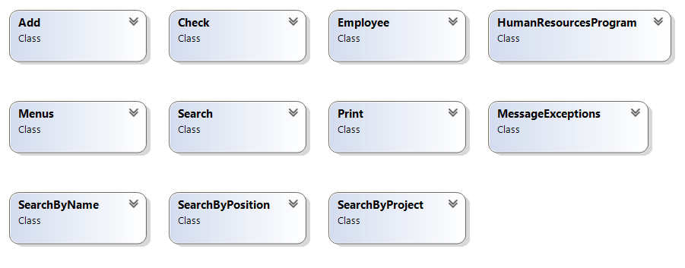
Structure
Namespace
HumanResourcesSystem;
Classes:
HumanResourcesProgram
Employee
Menus
Add
Search
SearchByName
SearchByPosition
SearchByProject
Print
Check
MessageExceptions
Class Diagram

Slide 5
Classes - methods
HumanResourcesProgram class – containing the “main” method
Employee class – containing fields, properties, getters and setters of the employees
Menus class – containing two methods with menus information

Slide 6
Classes - methods
Add class – containing the logic of adding new employees, and it has private methods:
addProject;
addProjectManager;
addTeamLeader;
addDeliveryDirector;
addCeo;
addNewEmployee;

Slide 7
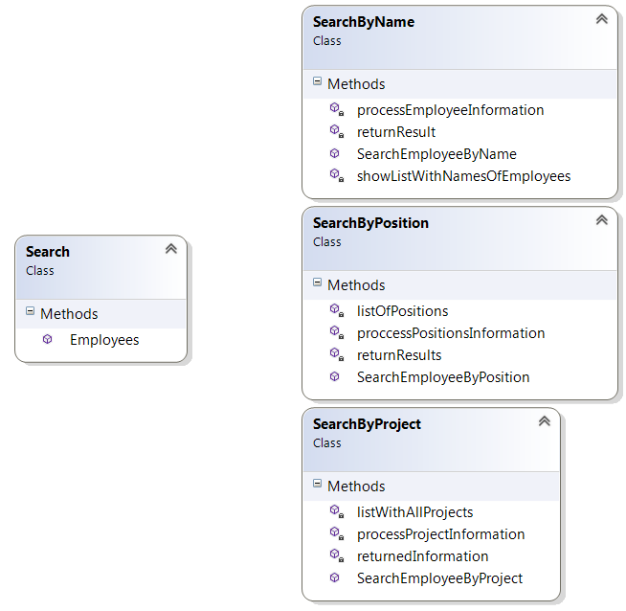
Classes - methods
Search class – containing the logic of searching employees in public method Employees, and invoke methods:
SearchEmployeeByName
SearchEmployeeByPosition
SearchEmployeeByProject

Slide 8
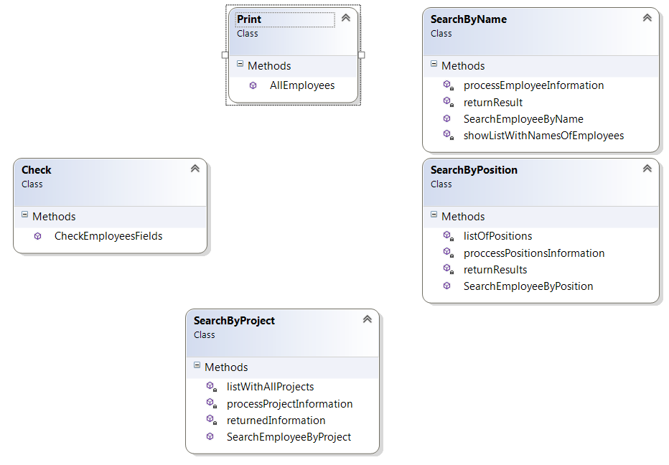
Classes -methods
Check class – containing method CheckEmployees which checks if searching is related to something that exists in the program.
It is used by four methods in four classes.

Slide 9
Classes -methods
Print class – containing method AllEmployess and invokes CheckEmployees method from Check class to output all the employees.
MessageExceptions class – contain methods which contains messages

Slide 10
Thank you for watching!
Trifon Trifonov

